Slide 1
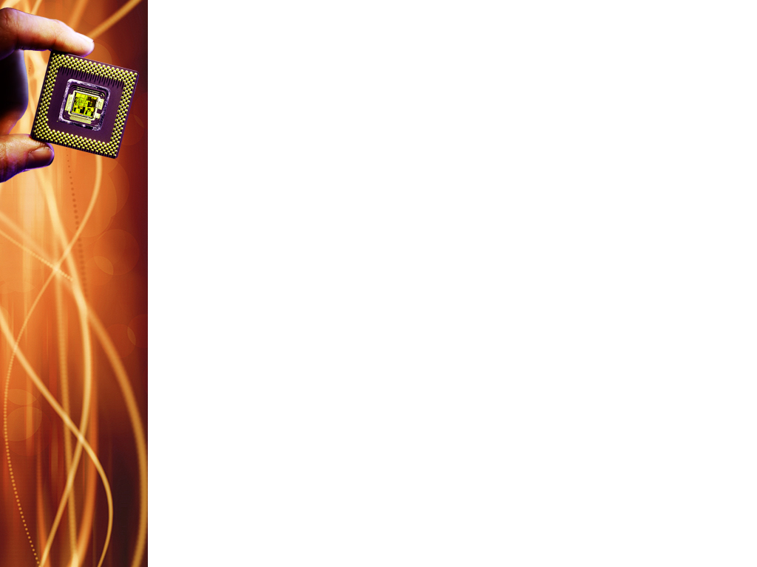
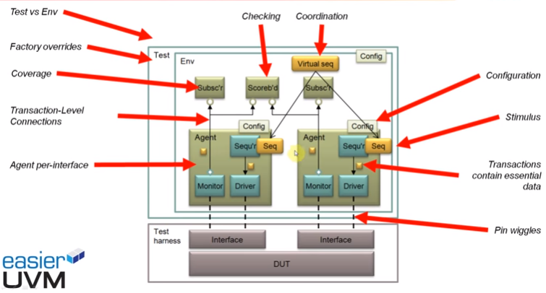
Notes:
Subscribers are used for functional coverage collection.
Scoreboard is used for end-to-end checking or SV assertions can be built into the interfaces for checking purpose.
Virtual sequence is used for centralized control. They provide a centralized point of control for starting, stopping, and coordinating sequences, which is much easier to manage compared to handling these tasks within multiple individual sequences.. Virtual sequences allow for the synchronization and management of multiple sequences that are running on different sequencers or driving stimulus to different interfaces. This is especially useful in complex testbenches where multiple interfaces or components need to be stimulated in a coordinated fashion.

Slide 2
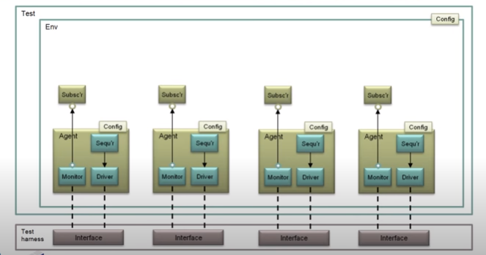
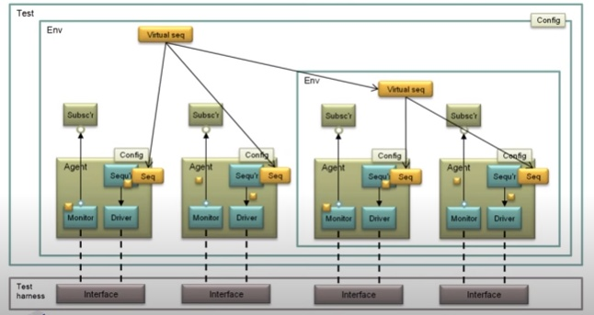
UVM Code generator
Notes:
With regard to UVM code generator, the structure displayed will get code generated accordingly based upon the set of template files and include files that are provided.
Template files are provided for each of the interfaces and the code generator generates code for each of the interfaces shown. This means that code will be generated for the agents, components within agents and the subscribers. As well as for sequences, transactions and virtual sequences.

Slide 3
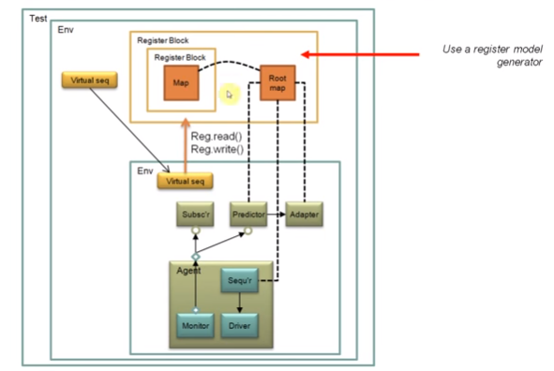
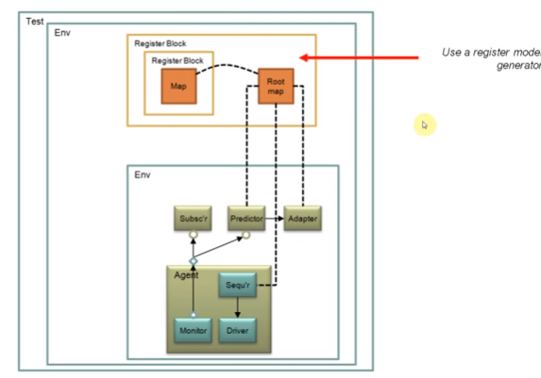
Register layer
Notes:
The UVM register layer defines several base classes that, when properly extended, abstract the read/write operations to registers and memories in a DUT.
A register model is typically composed of a hierarchy of blocks that usually map to the design hierarchy. Blocks contain registers, register files, and memories.
So, with the use of the register layer, you can read or write registers within the register model by name, without knowing precise addresses of the register within the register map.
A register model is instantiated within the top level env. There is a register model generator to generate code for register model. The register model gets instantiated in the env along with necessary predictor and adapter components for each agent and make the necessary connections.
The virtual sequence in the top level env will start a virtual sequence associated with the specific agent, that will then make reads and writes into registers within the register model.
The registers in the register model would have been connected with an address map to the components within the UVM verification environment.

Slide 4
Universal Verification Component (UVC)
UVC
A UVC can have several agents inside (eg: an AHB UVC can have master and slave agent inside).
Interface UVC
Module UVC
Active for stimulus driving
Passive for checkers / monitors / scoreboards of DUT

Slide 5
Universal Verification Component (UVC)
Reusable, pre-verified, configurable, plug & play
Complete package :- provides all the logic required for verification
Examples:
Interface components
Bus based UVCs (eg: PCI, AHB)
Communication UVCs(eg: Ethernet, MAC)
Module UVCs (eg: UART core, ALU)

Slide 6
UVM Class Libraries
UVM has class libraries (a set of base classes with methods defined in it)
Needed for development of well-constructed, reusable SV verification environment (done by extending the base classes).
Three main types of UVM classes:
uvm_object
uvm_transaction
uvm_component

Slide 7
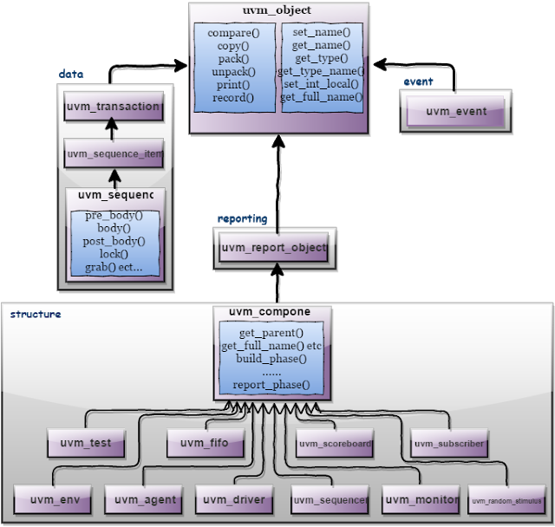
UVM Class Libraries

Slide 8
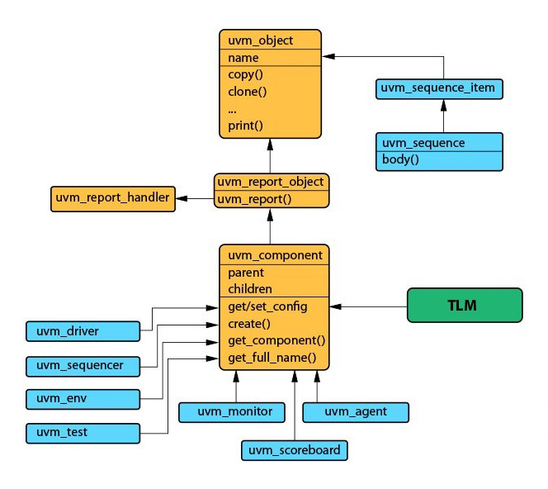
uvm_object
Utility macros: `uvm_object_utils(type)
Field macros:
`uvm_field_*(field,flag)
Notes:
uvm_object:
This is the main class
Core class based operational methods (create, copy, clone, compare, print, record, etc..), instance identification fields (name, type name, unique id, etc.) and random seeding are defined in it.
All uvm_transaction and uvm_component were derived from the uvm_object. Classes derived from uvm_object must implement the pure virtual methods such as create and get_type_name.
For example: uvm_object is used to write a uvm_sequence item. The virtual methods in uvm_object can make sequence_item purposeful.
uvm_object has utility macros & field macros. The utility macros provide implementations of the basic methods such as create. When you are trying to write objects without any field macros, its written as `uvm_object_utils(type).
UVM field macros are useful typically for the implementation of methods such as copy, print, pack, unpack, etc. They are invoked inside the `uvm_object_utils_begin and `uvm_object_utils_end. The macro basically has two arguments as part of it: field and flag.

Slide 9
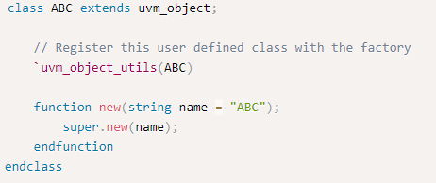
UVM utility and field macros
Utility macros
The utils macro is used primarily to register an object with the factory
Required to be inside every user defined class derived from uvm_object
Object Utility
All classes derived directly from uvm_object or uvm_transaction require them to be registered using `uvm_object_utils macro.

Slide 10
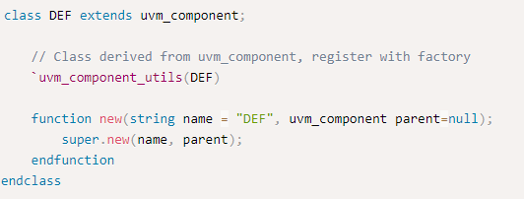
UVM component utility
All classes derived directly or indirectly from uvm_component require them to be registered with the factory using `uvm_component_utils macro.
It is mandatory for the new function to be explicitly defined for every class defined directly or indirectly from uvm_component.
This takes the name of the class instance and a handle to the parent class where the object is instantiated.

Slide 11
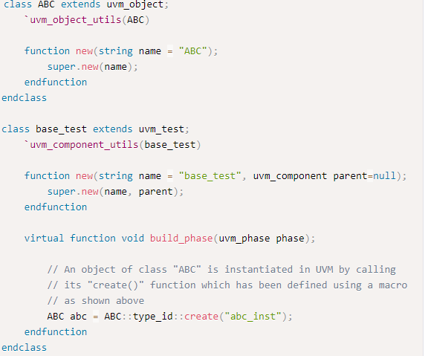
Creation of class object
Class objects are created by calling the type_id::create() method
This makes any child class object to be created & returned using factory mechanism

Slide 12
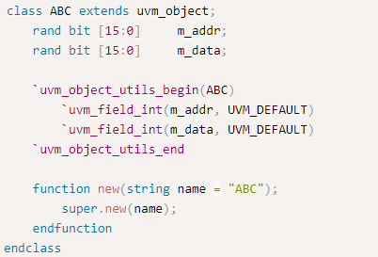
Field Macros
`uvm_field_* used between *_begin and *_end utility macros are field macros
They operate on class properties
Provide automatic implementations of core methods like copy, compare and print.
`uvm_field corresponding to the data type of each variable should be used :
int, bit, byte should use `uvm_field_int
String should use `uvm_field_string

Slide 13
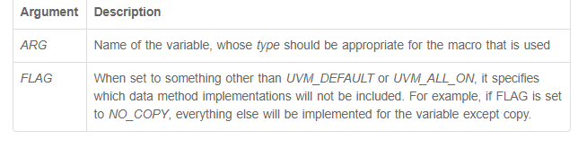
Field Macros
Field macros accept atleast two arguments: ARG, FLAG

Slide 14
UVM Class Libraries
FLAG | Description
UVM_ALL_ON | Set all operations on (default)
UVM_DEFAULT | Use the default flag settings
UVM_NOCOPY | Do not copy this field
UVM_NOCOMPARE | Do not compare this field
UVM_NOPRINT | Do not print this field
UVM_NODEFPRINT | Do not print the field if it is the same as its
UVM_NOPACK | Do not pack or unpack this field
UVM_PHYSICAL | Treat as a physical field. Use physical setting in policy class for this field
UVM_ABSTRACT | Treat as an abstract field. Use the abstract setting in the policy class for this field
UVM_READONLY | Do not allow the setting of this field from the set_*_local methods

Slide 15
UVM Class Libraries
A radix for printing and recording can be specified by OR’ing one of the following constants in the FLAG argument
UVM_BIN | Print/record the field in binary (base-2)
UVM_DEC | Print/record the field in decimal (base-10)
UVM_UNSIGNED | Print/record the field in unsigned decimal (base-10)
UVM_OCT | Print/record the field in octal (base-8).
UVM_HEX | Print/record the field in hexadecimal (base-16)
UVM_STRING | Print/record the field in string format
UVM_TIME | Print/record the field in time format

Slide 16
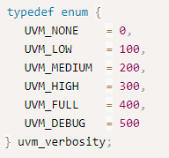
UVM Reporting Functions
Most of the verification components are inherited from uvm_report_object (they already have functions and methods to display messages)
4 basic reporting functions : info, error, warning, fatal, and these are used with 6 levels of verbosity.
The verbosity level is required only for uvm_report_info.
Use of uvm_report_fatal will exit the simulation

Slide 17

UVM Reporting Functions
Verbosity Levels:
Controls whether a uvm_report_* statement gets displayed or not
If verbosity settings has been configured to UVM_HIGH, every uvm_report_* or `uvm_* message with verbosity level less than UVM_HIGH will be printed.
If configured to UVM_LOW, then only UVM_LOW and UVM_NONE lines will be dumped out.
Default configuration is UVM_MEDIUM

